Slide 1
SKILLS USA
Chef Brian Griswold

Slide 2
Ct. State Level Competition
Culinary Arts
Food and Beverage Service
Commercial Baking
Customer Service
Job Skills Demo

Slide 3
Timelines for State Competition
January / Written Test
Culinary Arts-Multiply Choice
Food and Beverage Service – Multiply Choice
Commercial Baking – Multiply Choice
Customer Service -?
Job Skills Demo -?
Student Testing and Participation

Slide 4
State / National Culinary Menu Requirements
STATE
NATIONALS
Composed Salad with Emulsified Dressing
Chicken Vegetable Soup
Chicken Entrée with Sauce
Starch and Vegetable
Composed Salad with Emulsified Dressing
Chicken Vegetable Soup
Sautéed Chicken Breast with Mushroom Pan Sauce
Brown Rice Pilaf / Sautéed Spinach with Julienned Carrots
Deep Poached Salmon with Warm Vinaigrette – Parsley Potatoes and Braised Belgian Endive

Slide 5
Skills Components
Vegetable Cuts – Mince, Chop, Brunoise, Julienne, Batonnet, Dice, Concassee, Chiffonade
Meat Fabrication – Chicken / Fish
Chicken Broth or Stock
Handling and Cleaning of Salad Greens
Emulsion Dressing
Soup – may include any of the following: Cream , Puree or Clear
Main Entrée – 2 Different Cooking Techniques from the following - Sauté, Roast , Braise, Stew, Poach( shallow or deep)
Sauces 2 Different Types from the following – Cream , Pan ,Au jus, Gravy, Butter Sauce, Warm Vinaigrette
Vegetable Cookery- May include any of the following: Boiling, Steaming, Glazing, Sauté, Roasting, Pan Frying, Braising ,Stewing
Starch Cookery- May include any of the following: Rice Pilaf, Grains, Risotto, Potatoes – Roasted, Pureed, Pan Fried, Boiled, Steamed

Slide 6
State Equipment List
Quantity | Student Equipment
 | Standard Knife Kit, thermometer & tongs
2 ea. | Sauté pans (8” -10”)
2ea. | Sauce pan (4 –5 Quart)
1ea | Pastry bag with tips
2ea. | 2” half hotel pans
2ea. | Small SS Bowls
3ea | Aluminum pie Tins (9”)
1ea. | Solid spoon, slotted spoon, whisk
 | Tasting spoons, plastic gloves, Squirt bottle
1ea. | Counter top butane burner, gas separate
8ea. | 8oz soup containers for food storage
 | Molds or timbales
1ea | Bench scraper

Slide 7
Judging Score Guide
Items Evaluated | Possible Points | Judges Score
Written Test | 100
Sanitation – ServSafe Standards | 100
Mise en Place | 75
Knife Skills / Meat Fabrication | 75
Salad Course | 150
Soup Course | 150
Entrée Course | 150
Total Points | 800
- Clothing Penalty | 0 to – 50
-Time Penalty | 0 to – 50
-Other Penalty | 0 to – 50

Slide 8
Course Scoring Guide
Course
Menu Matches Food Produced | 15
Eye Appeal / Food Design on Plate | 20
Temperature | 15
Correct Cooking Method / Preparation | 35
Flavor and Seasonings Complement / Taste | 35
Food Doneness / Integrity | 30
Total | 150

Slide 9
Mise en Place Scoring Guide
Mise en Place
Plan of Work | 15
Station Organization / Above & Below/ Garbage | 25
Refrigeration Organization / HACCP | 10
Equipment List | 10
Work Flow / Production | 15
Total | 75

Slide 10
Sanitation Scoring Guide
Sanitation &Safety
Knife and Equipment Safety | 25
Non Slip Shoes | 15
ServSafe Standards | 35
RTE / Use of Plastic Gloves | 10
Cleaning and Sanitizing Buckets | 15
Total | 100

Slide 11
Common Table Ingredients
Dry Goods | Produce | Dairy
Rice / Barley / Pasta | Salad Greens | Milk
AP Flour / Sugar | Spinach | H Cream
Bread Crumbs | Cuke / Tomato | Parm Cheese
Mustard / Vinegar | Carrot / Onion | Butter / Eggs
Canola / Olive Oil | Shallot / Red Onion | Blue Cheese
Walnuts | Celery / Mushroom
Bread | Potato /Gr Beans | Misc
Dried Herbs | Fresh Basil,Parsley | 2-4 oz.Cups
Proteins | Fresh Thyme | P Spoons
Whole Chicken | Garlic / Red Pepper | Gloves
Chicken Stock | Lemons / Oranges | Plastic Wrap
Beef / Chicken Base | Asparagus | Foil
 | Scallions
Wine if available

Slide 12
State Event Time table
8:30 Student arrive, Review Guidelines
9:15 Set up Kitchen stations
9:30 Student begin cooking
12:15 Service window opens, plate earlier?
12:35 service window closes
12:45 Clean up
1:30 Student lunch and overall review

Slide 13
Basic Production Guidelines
Each Student will produce 2 portions; Soup, Salad & Entree
Food Safety & Sanitation Reminders
Mise en Place, copy of Plan of Work to Judges
Knife Skills, accuracy in cuts
Portion and Nutritional balance ( Plates supplied)
Presentation – Visual, aroma & taste, hot / cold
Waste – containers (2) on student bench, perishable & non, over production considered waste
Full utilization of product, chicken- bones, meat, skin
Final Plate Presentation – One in Bakery & one in Dining Room, look for corresponding participant number
Any items presented 15 min late will not be scored(5/10- 25%, 10/15-75% point deduction)
Unused equipment, knife holders, off to side
Clean up very important,

Slide 14
Skills Summary
Select skills candidates through Fair selection process
Review guidelines and practice schedule with student and seek long term commitment.
Student create menu from product list, Instructor finalize
Practice (home & school) and create plan of work

Slide 15
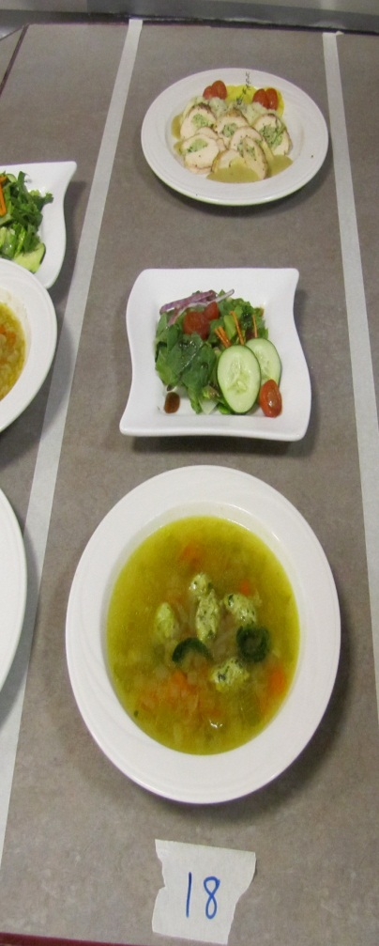
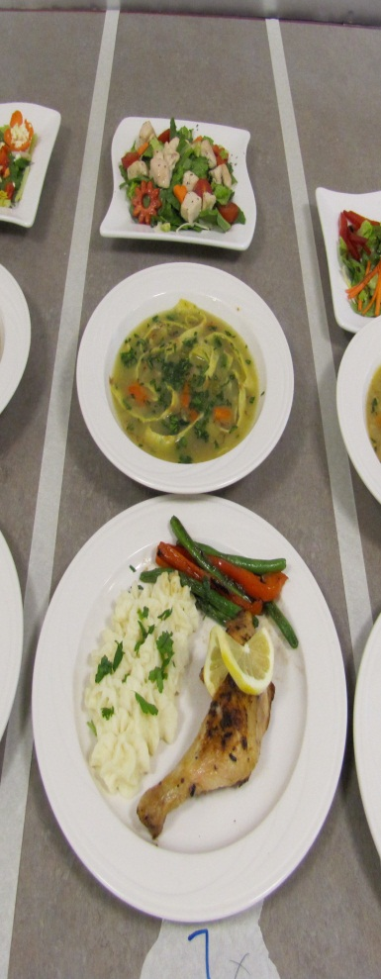
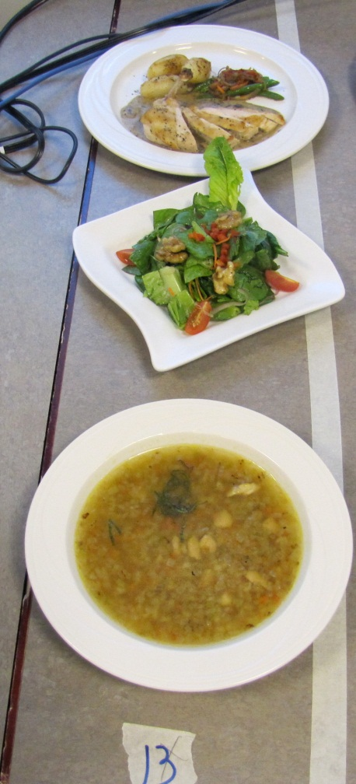
State Student Work

Slide 16
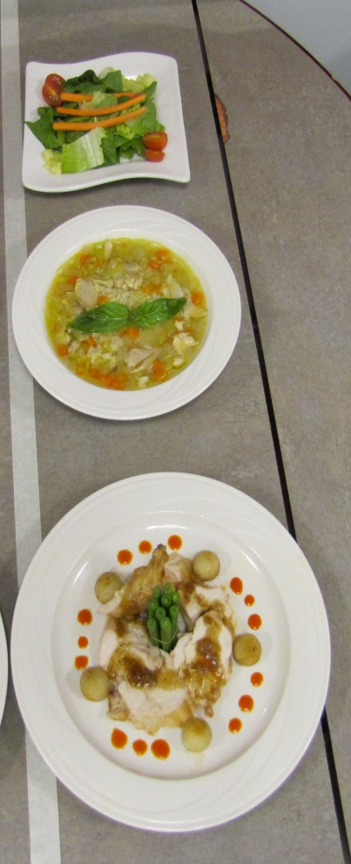
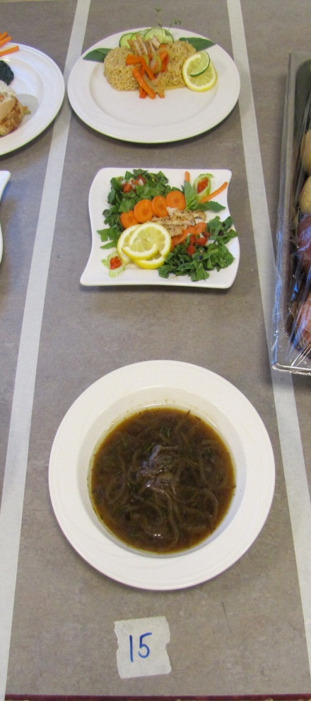
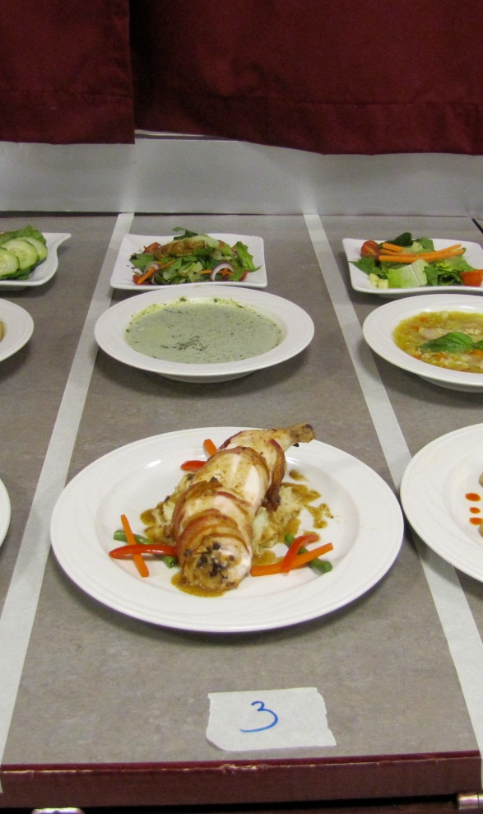
Skills Student Work

